Slide 1
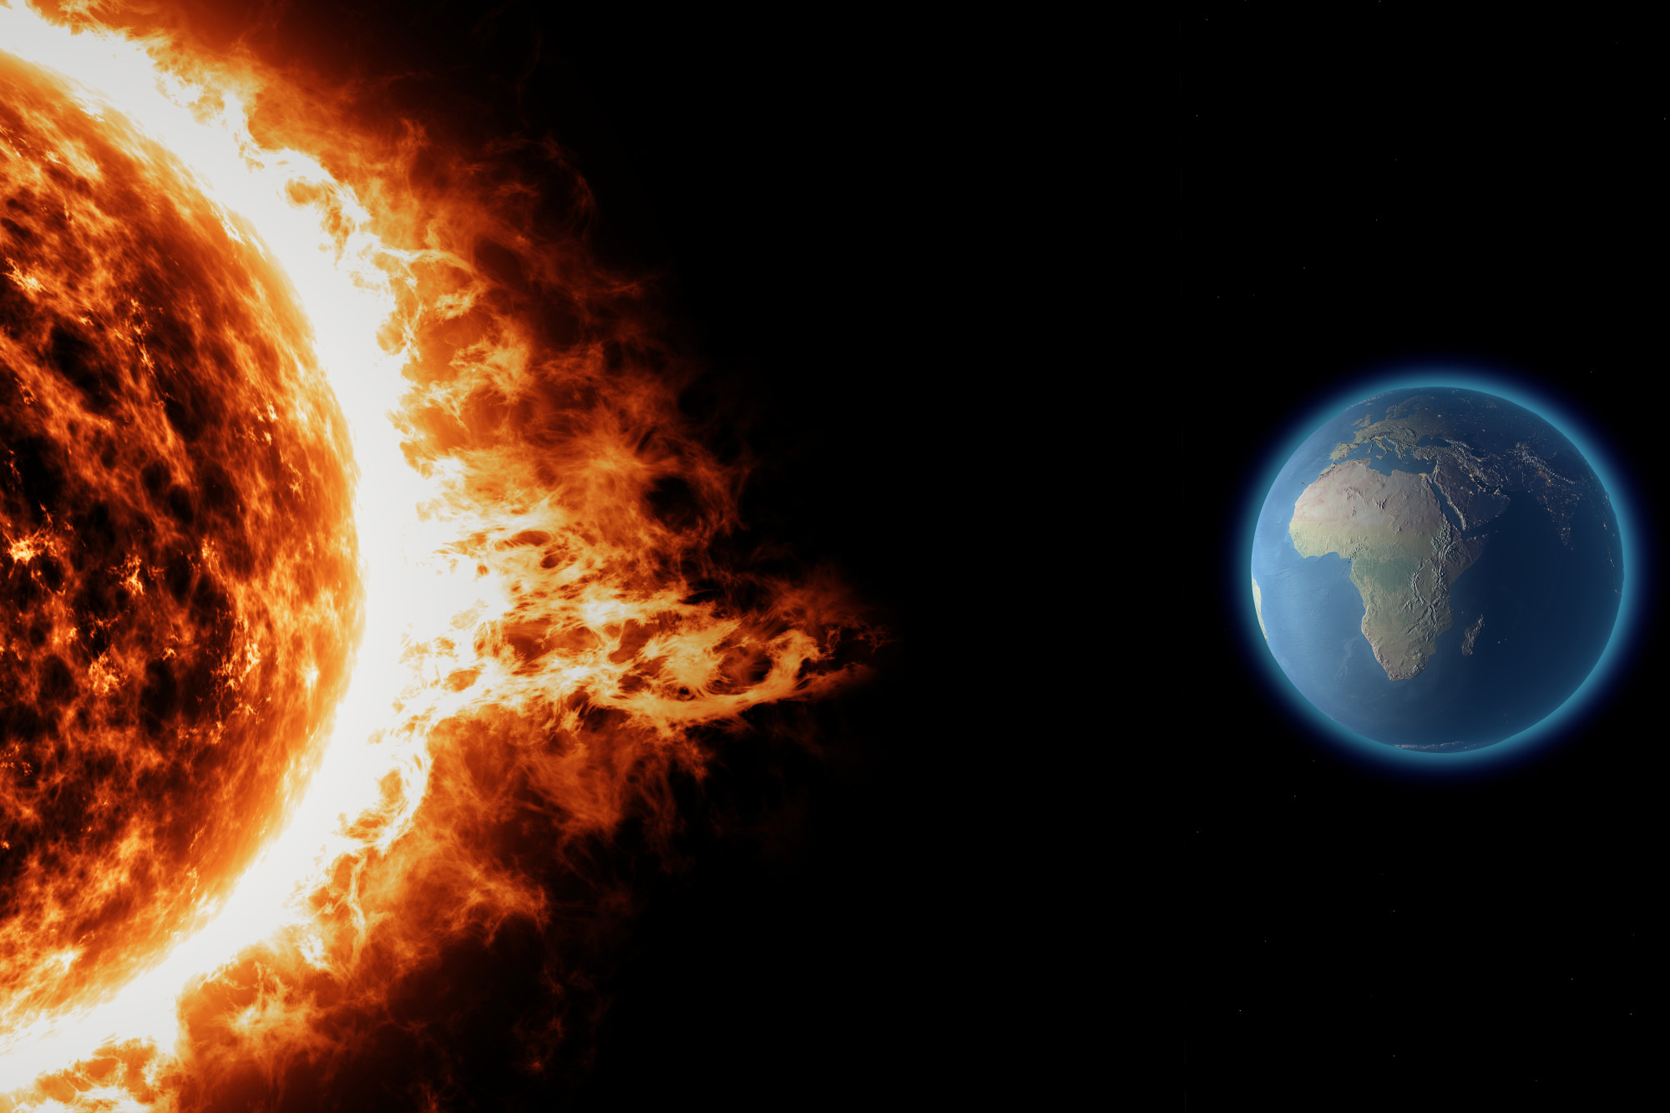
Future Solar Storm Escape Room
The Future World & The Incident
The Escape Room Story
Main Goal
Real Grid-Control Room examples
Solar Storm facts
Real Life happenings/Links

Slide 2
The Future World & The incident
Year 2050
Autonomy of smart grids has increased a lot
Blind trust in technology
(Famouse last words: "this system has never failed!")
Climate is significantly warmer
Huge energy consumption due to AC’s, cooling etc.
Electric Grid on its limit already
Solar storm overloaded the electric grids
Whole country is without power!
Danger of an Apocalyptic Crysis!

Slide 3
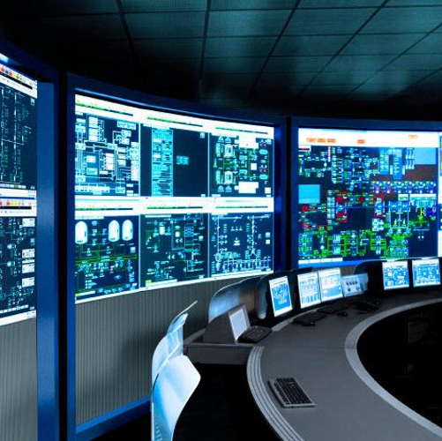
The Story Wrong Place Wrong Time
Tour at autonomous Power Supplier (feint)
Tells us how important and reliable
runs autonomous for ages...
rough and superficial introduction
Tourguide leaves for important phonecall...
SOLAR STROM is happening!
Strong Aurora is visible in the sky (Screen as window?)
Hard shut down of everything (short darkness)
Emergency system turns on (automaticly) BUT
Bad lighting (flickering lights, emergency lights)
Control System is obviously malfunctioning
"System-Startup-Fail" error messages visible on screens

Slide 4
The Story What now ?
Fatal ERROR !
tour guide made clear:
System is autonomous since ages
no experts around
How Important it is in 2050
To cool homes, Hospitals, Traffic etc.
Why smart grids must be managed
“In May, the National Grid [UK] powers to switch off solar and wind farms and warneasked for emergency d of blackouts and a “significant risk of disruption to security of supply.””[1]
Players need to act fast to prevent disaster
Save supplier and City from total catastrophe
Save lives
[1] What Do We Do With Too Much Renewable Energy? | Sierra Club
Fatal ERROR !

Slide 5
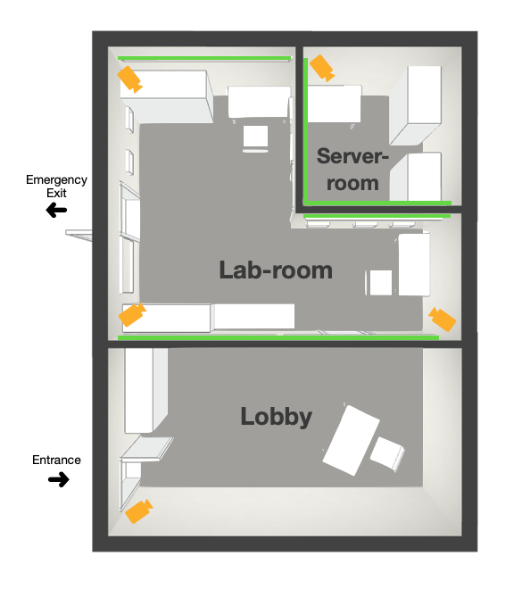
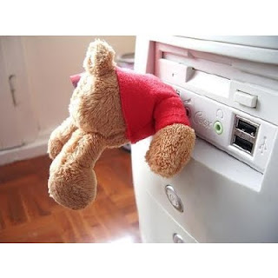
The Game Hints, Tasks and Goal
Left alone by tour guide in Lobby
error screens visible through glass
How to get access to Control-Room?
Emergency broadcast in Radio
Information of blackout reason
updates about outside (Future)world
End Goal
getting The Control-Software uploaded back on the Server (USB, floppy disc, futuristic storage device, not obvious)
Control Room

Slide 6
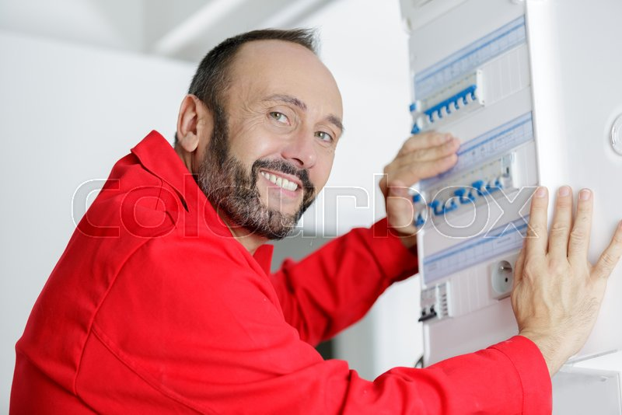
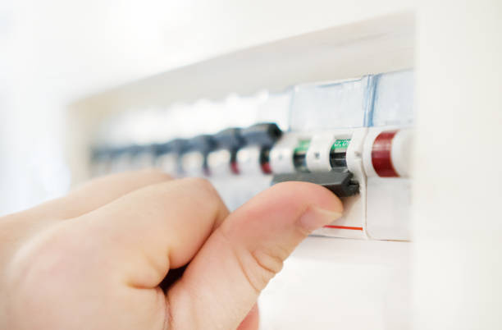
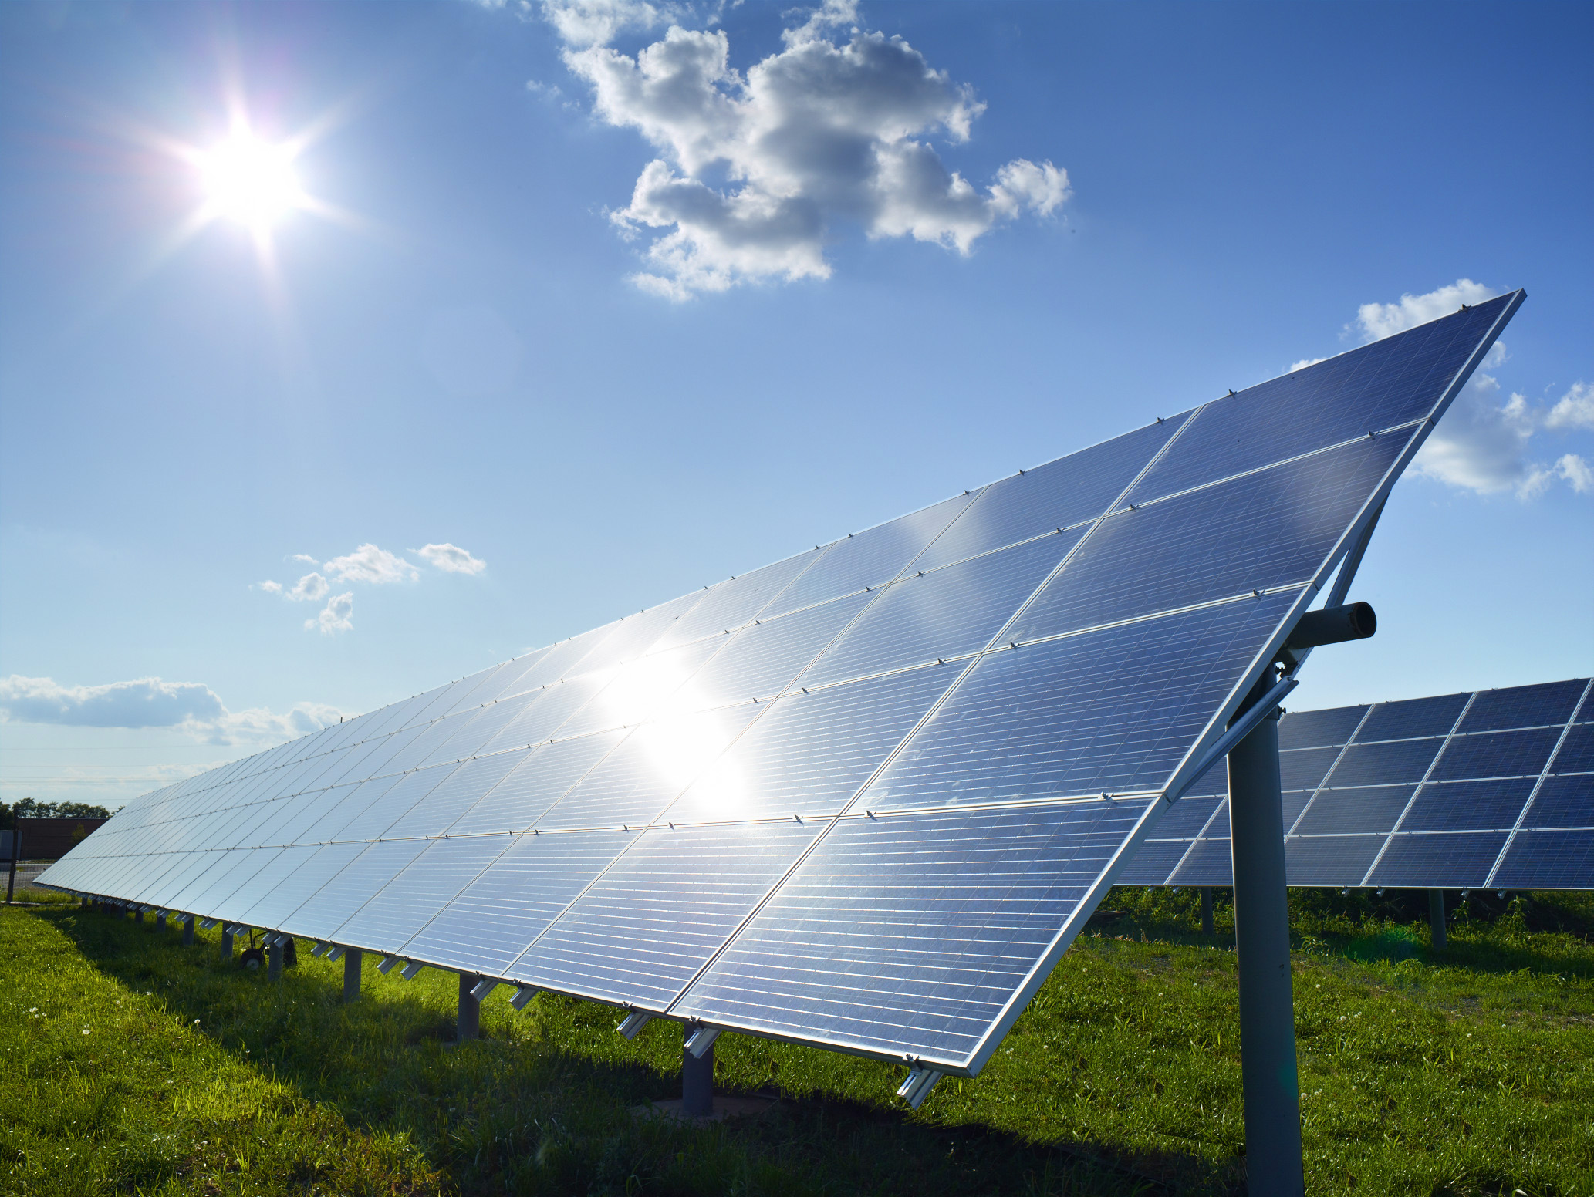
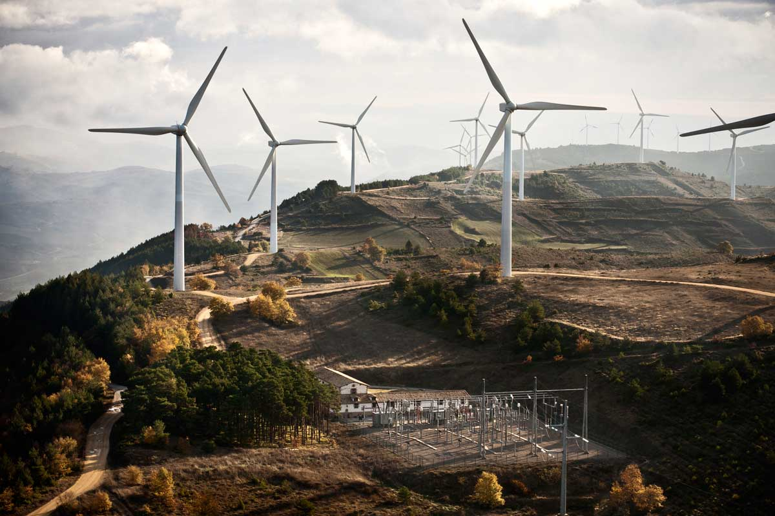
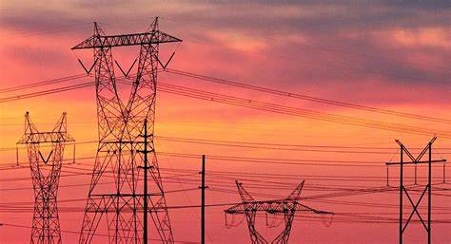
Goal
Main target is to bring power back up
Fuse/critical part needs to be replaced
Wires need to be replaced
Smart Grid controller needs to be fixed(software)->renew logic, embedded system in the supplier's network needs to be repaired/replaced
???
Many different (renewable) power sources need to get back on the grid again
Grid stabilization ???

Slide 7

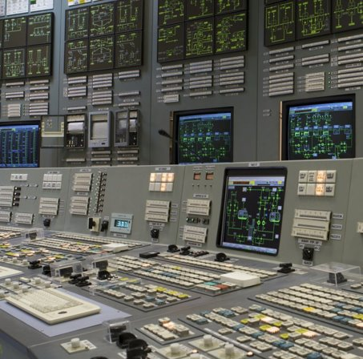
Old "Analog" outdated Control Center

Slide 8
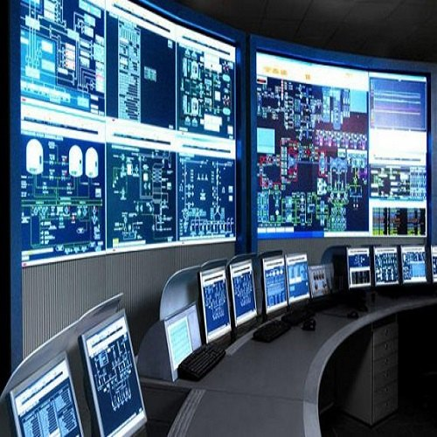
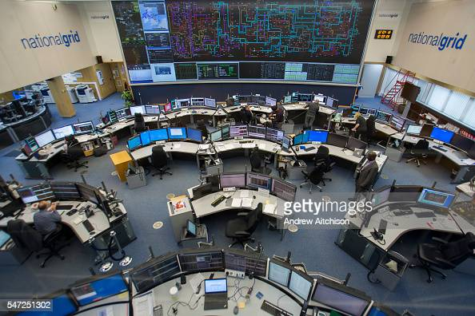
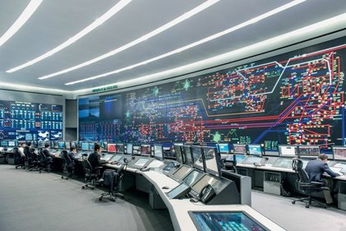
Digital/Modern Control Center

Slide 9
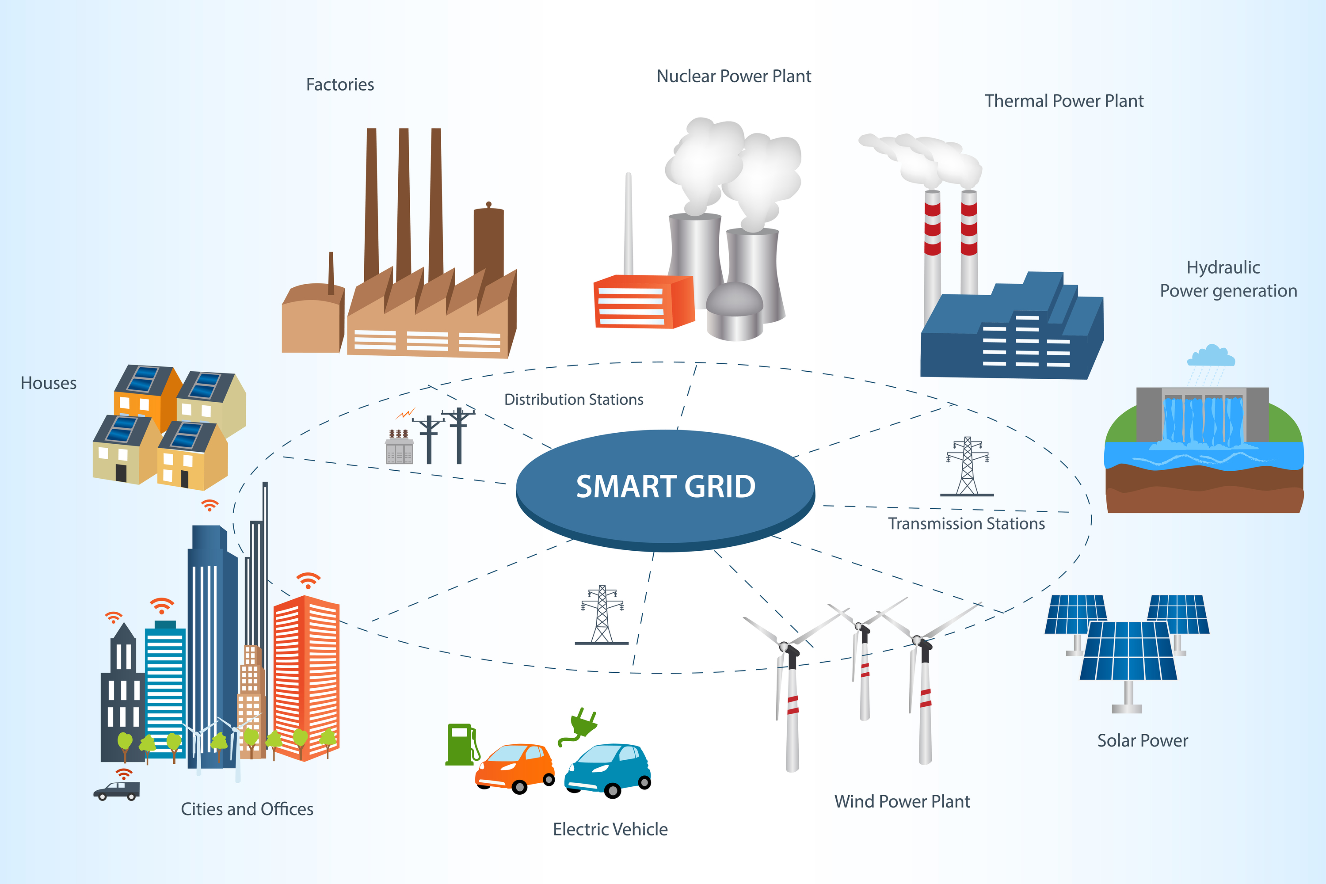

Slide 10
Solar storm facts
Solar Eruption eject high energy particles
the cause of polar lights (auoras)
satelite communication breaks down
Highly important in aviation
Long distance power lines act like antennas
Large grids are prone to pickup a lot of electrical energy
ESA is observing Solar activity
Eager to sensitize operator of critical infrastructures to test and protect against such scenarios
https://www.br.de/wissen/solar-orbiter-sonneneruption-sonnenwind-weltraumwetter-flares-esa-nasa-100.html

Slide 11
too much green power poses problems for energy supply
What Do We Do With Too Much Renewable Energy? | Sierra Club
1989 the entire province of Quebec, Canada suffered an electrical power blackout caused by a solar storm
The Day the Sun Brought Darkness | NASA
Bit flip caused by high energy particle (most likely from supernovae and black holes but that’s just a detail)
The Universe is Hostile to Computers – YouTube
Sun activity tracker (and aurora forecast)
Current Space Weather - Space Weather (esa.int)
Homepage | NOAA / NWS Space Weather Prediction Center

